Slide 1

Management of variceal and non-variceal UGIB-Band,Inject,Burn,Clip or do them all?
Prof Arjuna De Silva
MBBS,MD,MSc(Oxon),FRCP(Lond),FCCP,AGAF,FNASSL
Department of Medicine University of Kelaniya
Consultant Physician

Slide 2
History 1
A 45 yr old man presents with haematemesis (2 pints)
Previously well consumes 1 bottle of arrack for the past 15 yrs
An accountant by profession married with 2 children

Slide 3
History 2
A 56 yr old man was admitted to CNTH on Friday at 5 pm with haematemesis
Half a pint of fresh blood.
He was diagnosed with rheumatoid arthritis 5 years ago and was on NSAIDS and leflunamide
No other significant past history
Teetotaler

Slide 4
Introduction
Commonest GI emergency
Incidence is 100/10000/year in UK
Mortality 10% in the UK
Varices is the commonest cause in Sri Lanka
Peptic ulcers, Mallory-Weiss tear, oesophagitis, gastritis, erosions,vascular anomalies, carcinoma oesophagus

Slide 6
Management
Resuscitation - (ABC)
History - Onset, Melaena Alcohol, NSAIDS, P/H
Examination – Shock, Liver disease, Haemagiomas
All at the same time!

Slide 7
Rockall score
Variable Score 0 Score 1 Score 2 Score 3
Age <60 60-79 >80 -
Shock None Pulse>100 BP<100 -
Co morbid None - Cardiac Renal or Liv
Diagnosis None - Oesoph mal -
Mallory-Weiss
Major stig None - Blood in lum
of recent Clot
haemorrhage Visible vessle

Slide 8
Resuscitation
ABC
IV fluids crystaloids, colloids
Blood (keep Hb >7) DT 4-6 pints
Platelets (if <50,000) or long term ant platelet drugs
FFP if (INR>1.5)
NG tube (controversial)
Monitor (pulse, BP, CVP)

Slide 9
Evidence
Target to tranfuse blood is Hb <7g/dl
Hb >9g/dl if IHD
Barkun et al. International consensus recommendations on the management of patients with NVUGIB . Ann Intern Med 2010;152:101.

Slide 10
Endoscopy
After resuscitation
Within 24 hours (ASLD guide lines within 12)
Experience
Nasal prongs,
Monitor, pulse, BP saturation

Slide 11
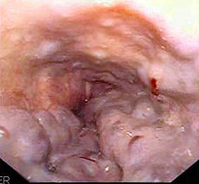
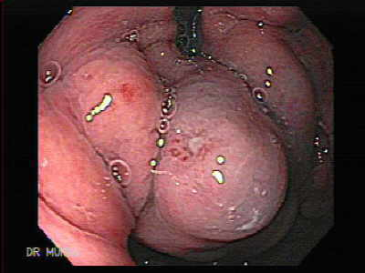
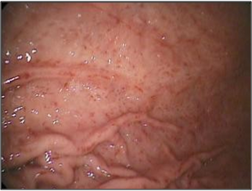
Causes of upper GI bleeding in portal hypertension

Slide 12
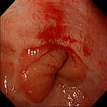
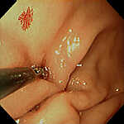
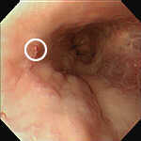
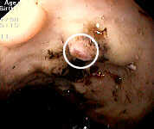
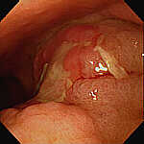
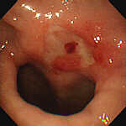
Causes of upper GI bleeding

Slide 13
Varices
Medical
IV Terlipressin- 2mg bolus then 1mg
4-6 hr for 48 hr (only drug to affect mortality)
IV Vasopressin ( given in combination with nitrate) 0.4 u bolus then 0.4u/min infusion
Somatostatin 250mic bolus , 250/hr infusion for 5 days
Octreotide 50mic bolus, 50mic/hr for 5 days

Slide 14
Evidence (1)
Terlipressin - is as good as sclerotherpy and has less side effects and decreases mortality- TEST Trial
Somatostatin - Better than vasopressin, as good as sclerotherapy
Octreotide as good as somatostatin
Vasopressin - Only for Sri Lankans!

Slide 15
Endoscopic treatment
Banding (Better both long term and preventing re bleeding)
Sclerotherapy
Glue cyanoacrynalate(used for gastric varices)
Combination therapy (medical + endoscopic is better than either alone)

Slide 16
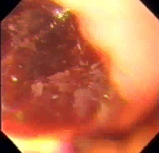

Banding

Slide 17
Evidence (2)
Combination of medical therapy with endoscopic therapy is better that either alone
Banding is better than sclerotherapy (lower re-bleeding, mortality, complications- Ann int medi 1995 :15;123(4): 280-7.
Combining banding and sclerotherapy has no benefit – Hep 1997 :25(1):71-4.

Slide 18
Concomitant treatment
IV Ceftrioxone 1g bd *
Omeprazole 40mg iv or oral
Alcohol withdrawal
Thiamine 100mg
Nutritional support
* Fernandez J et al. Norfloxacin vs Ceftrioxone in the prophylaxis of infections in patients with advanced cirrhosis and haemorrhage .Gastroenterology 2006;131:1049-56

Slide 19
If bleeding continues?
More than two episodes of uncontrolled bleeding
Activated Factor VII ?
Sengstaken tube
TIPS (Childs A&B)
Surgery (Childs A&B)
Transplantation

Slide 20
Activated Factor VII
Easy to administer difficult to afford!
Small trials showed benefit
Larger RCT’s no benefit *
Jury still out
*BoschJ et al. Recombinant factor VIIa for upper GI bleeding in patients with cirrhosis : a randomized double blinded trial. Gastroenterology 2004;127:1123-30

Slide 21
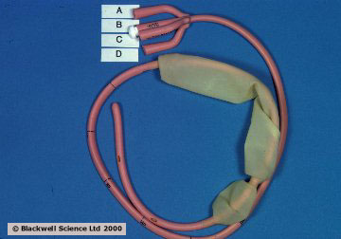
Sengstaken Tube
To buy time for TIPS
Maximum 24 hr

Slide 22
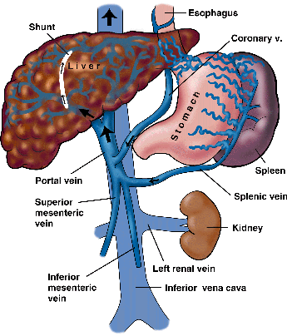
TIPS
Trans jugular intra hepatic systemic shunt
Bridge to transplant
Gives rise to encephalopathy

Slide 23
Surgery
Non selective
(Oesophageal transection) or
Sugiura proceedure
Selective
(Distal splenorenal shunt )

Slide 24
Long term
Banding 6 weekly till varices obliterated
The 2 yr endoscopic surveillance
Propranolol
Carvedilol
Other co-morbid factors
*Carvedilol

Slide 25
Primary prophylaxis
All patients with cirrhosis should undergo endoscopy to determine the presence of varices
Grade >II should be given propranolol in a dose to reduce the HR >25%
Combination with Nitrates can be used although not standard
No place for monotherapy with nitrates
Banding may be better than propranolol

Slide 26
Primary prophylaxisis
Glue or propranolol ?
Glue better
Mishra SR, Sharma BC, Kumar A, Sarin SK.
Primary prophylaxis of gastric variceal bleeding comparing cyanoacrylate injection and beta-blockers: A randomized controlled trial. J Hepatol. 2011 Jun;54(6):1161-7. Epub 2010 Nov 5.

Slide 27
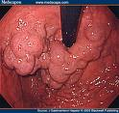
Gastric Varices

Slide 28
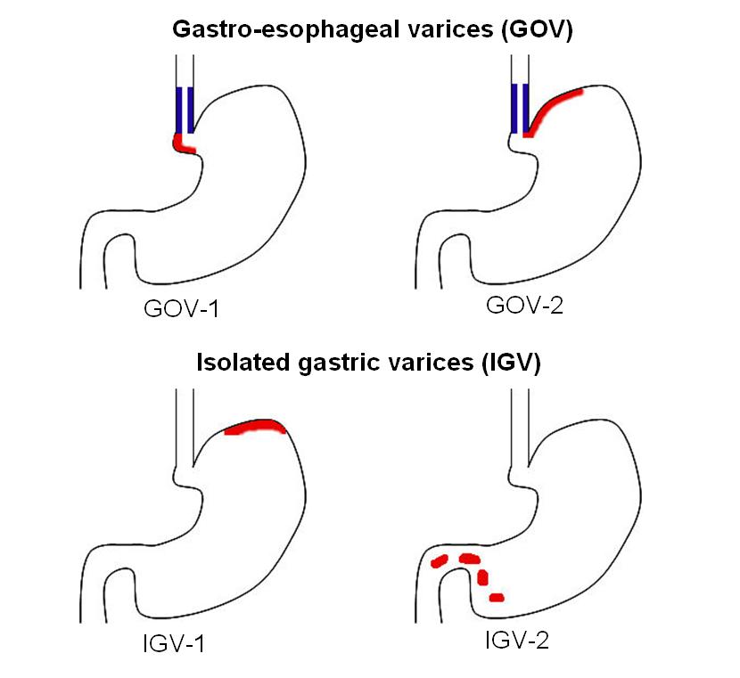
Classification of gastric varices

Slide 29
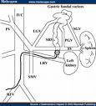
Treatment of gastric varices
Cyanoacrylate Glue injection
Intra varicial thrombin
B-RTO (Balloon occluded retrograde transvenous obliteration)

Slide 30
Portal hypertensive gastropathy

Slide 31
Management
Cornerstone is non selective beta blockers
Chronic bleeds will require iron therapy
PPI no evidence of benefit
Endotherapy mainly for GAVE
TIPPS

Slide 32
Peptic ulcer Medical Treatment
Start before endoscopy
IV omeprazole 80 mg bolus in 250 ml over 1hr then 8mg/hr for 72 hr
If not available use 40mg bid oral PPI
NO PLACE FOR H2 RECEPTOR ANTAGONIST
No evidence for Tranexamic acid*
*Gluud LL.Tranexamic acid for upper GIB. Cochrane Database Syst Rev.2012;1:CD006640

Slide 33
Adrenaline injection
Endoscopy and adrenalin injection
1/10000 adrenaline 10 ml
4 quadrant
Should not be used alone but with other endoscopic treatment

Slide 34
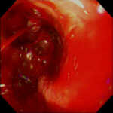
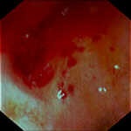
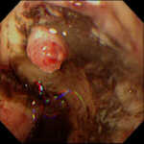
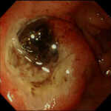
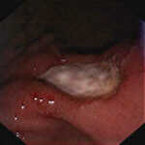
Forest Classification Peptic ulcers
Ia
IIa
III

Slide 35
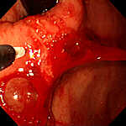
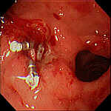
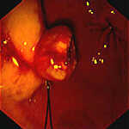
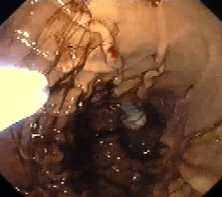
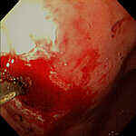
Endoscopic therapy

Slide 36
Other endotherapy methods
No difference between other endotherpy methods
Will depend on availability and expertise
We use adrenaline combined with haemoclips.

Slide 37
New endotherapy methods
Fibrin Glue
Hemostatic nano(Hemospray) powder*
Endoclot (starch polymer)
* Sung JJ et al. Early clinical experience of the safety and effectiveness of Hemospray in achieving hemostasis in patients with acute peptic ulcer bleeding. Endoscopy. 2011;43:291

Slide 38
Still bleeding
Second look endoscopy can be done once
Not routinely
Can try endotherapy but risky
Surgical opinion and surgery
TAE (Trans arterial embolization)*
* Gralnek IM. Will surgery be a thing of the past in peptic ulcer bleeding? Gastrointest Endosc. 2011;73(5):909

Slide 39
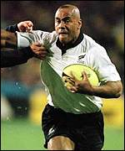
Know when to pass the ball to the surgeon!

Slide 40
On discharge
H pylori eradication
Cox II plus PPI

Slide 41
Summary
GI bleeding is a medical emergency and should be treated like that
Proper resuscitation and early endoscopy is essential
Combination of medical and endotherapy is better than either alone
Target Hb 7-8 in varices
Terlipressin is best medical treament
IV omeprazole infusion should be used in the treatment of peptic ulcers
Endotherapy should be based on availability. However, adrenaline should always be used in combination

Slide 42
Finally
Never do only one
Don’t try to do them all
Pick the best two and do them together !

